Slide 1
Window Programming 2-4
Mouse Events
Yuan Ze University

Slide 2
MouseDown, MouseUp, MouseMove, Click
MouseDown
  When the mouse is pressed down
MouseUp
  When the mouse is released up
MouseMove
  When the mouse is moving
Click
  When the mouse is pressed down and released up

Slide 3
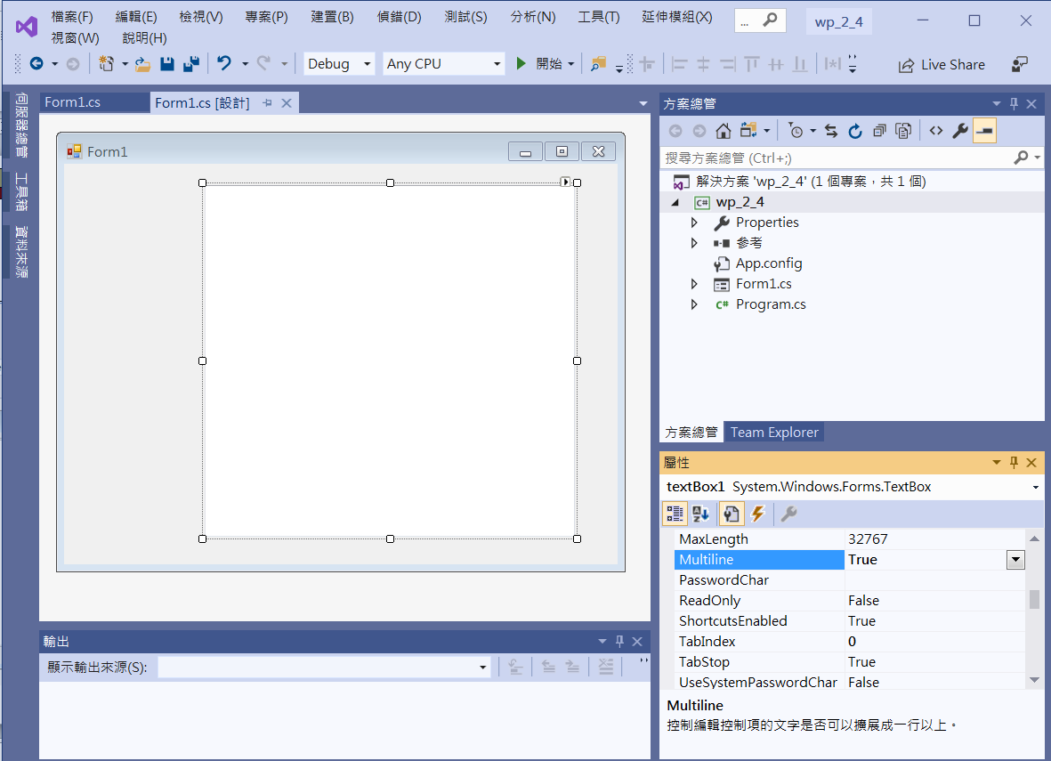
Edit interface
textBox1
Mutliline -> true

Slide 4
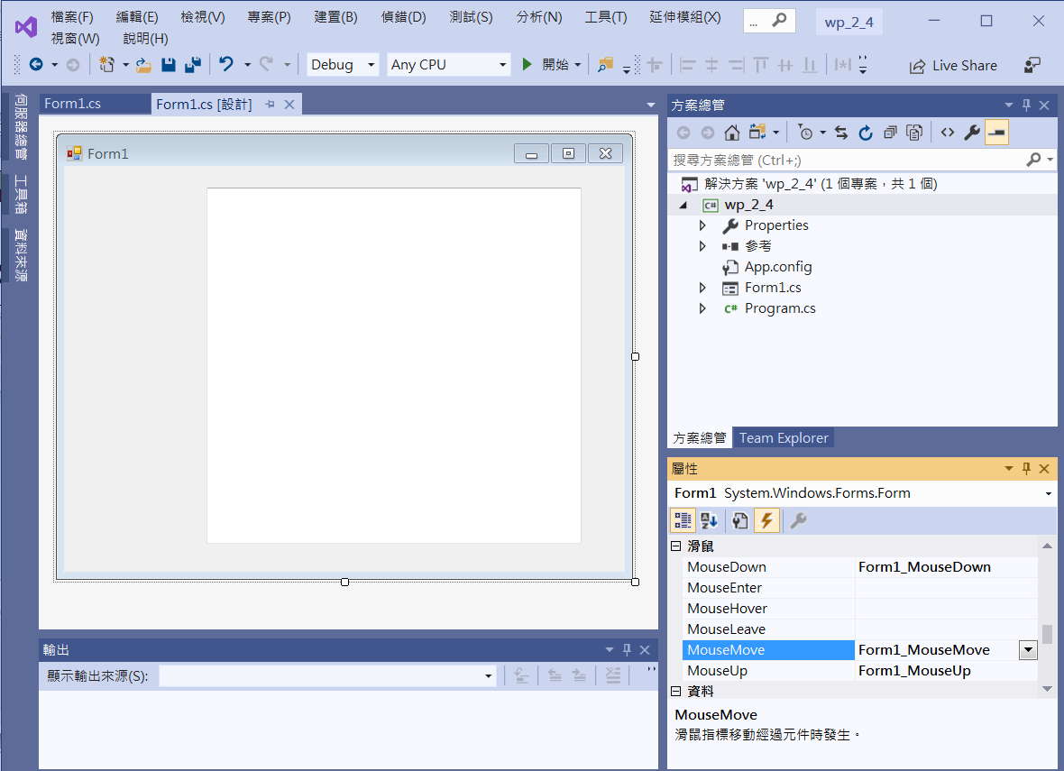
Add event functions
Click at Form1
Double Click at
MouseDown
Double Click at MouseMove
Double Click at MouseUp

Slide 5
Add event functions
private void Form1_MouseDown(object sender, MouseEventArgs e)
{
textBox1.AppendText("MouseDown at " + e.Location.X.ToString()+" , " + e.Location.Y.ToString() + "\r\n");
}
private void Form1_MouseUp(object sender, MouseEventArgs e)
{
textBox1.AppendText("MouseUp at " + e.Location.X.ToString() + " , " + e.Location.Y.ToString() + "\r\n");
}
private void Form1_MouseMove(object sender, MouseEventArgs e)
{
textBox1.AppendText("MouseMove at " + e.Location.X.ToString() + " , " + e.Location.Y.ToString() + "\r\n");
}

Slide 6
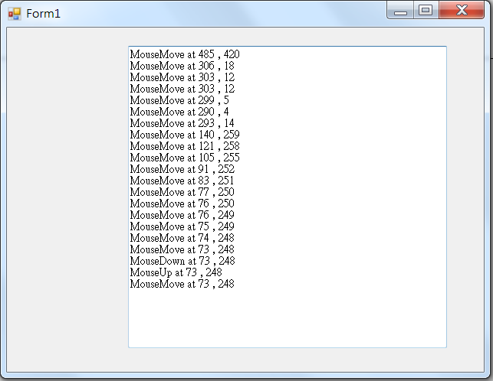
Exercise#2-4

Slide 7
內容來源
  Visual C# 2013視窗程式設計(黃聰明/著; 松崗)
  跟著範例學會Visual C# 2015(張逸中/著; 博碩)

